Slide 1
Endoscopic Image Classification based on explainable Deep Learning₁
by Doniyorjon Mukhtorov, Madinakhon Rakhmonova , Shakhnoza Muksimova, and Young-Im Cho
CSE707: Individual Presentation
Group No-6
ST: Ehsanur Rahman Rhythm
RA: Md Sabbir Hossain
Individual Presenter :
Nazia Parvin 23166034
Submitted To:
Annajiat Alim Rasel
Senior Lecturer, Department of Computer Science and Engineering,
Brac University.

Slide 2
Introduction
Endoscopic image classification using explainable AI involves the use of machine learning algorithms to classify images taken during an endoscopic procedure and provide explanations for the classifications made by the model.
This can be useful for identifying and diagnosing abnormalities or conditions within the body and for providing transparency and accountability in the decision-making process.
A number of approaches have reached high detection and classification accuracy by using a deep learning model but they could not explain the predictions properly.
A new approach is proposed to classify an endoscopic image by using the Inception-Resnet-v2 , ResNet-50, MobileNetV2, ResNet-152, and VGG16 models with a Grad–CAM model specific for explainable artificial intelligence.

Slide 3
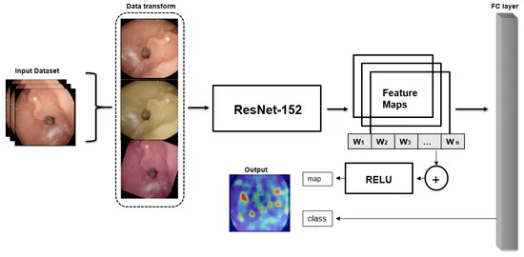
Methods and Materials
Study design
Data augmentation method is used to increase dataset size and efficiency
Train and test the dataset into several chosen CNNs to compare the best option for the classification of wireless endoscopic images to choose as a pre-trained mode
The third and last stage is to contribute to the classification of localized explainable areas using gradient explanation
Dataset
The KVASIR dataset is a publicly available dataset for endoscopic image classification contains 8000 images of digestive tract.
The dataset is split into train, validation, and test as an 8:1:1 ratio.
Figure 1. Overall architecture of the explainable AI for the classification of endoscopic images.

Slide 4
Methods and Materials
Data Augmentation
It was done using the the equation: g(x) = α( f (x) + β), where F(x) is the source pixel intensity, and g(x) is the output pixel intensity and parameter, image hue>2.
Classification of the Type of Gastrointestinal Disease Based on the CNN was done.
Visualization of Classification with Explainable AI:
The XAI methods used are Grad–CAM, Hires–CAM, Layer–CAM, Grad–CAM++, Xgrad–CAM, and Score–CAM

Slide 5
Experimental Result
Method | Train Accuracy(%) | Train Loss | Validation Accuracy)%) | Validation Loss | Epoch | Train Time(h)
DenseNet201 | 97.92 | 0.07 | 92.29 | 0.23 | 100 | 11.9
MobileNetv2 | 96.46 | 0.1028 | 92.37 | 0.18 | 100 | 6.1
ResNet-152 | 98.28 | 0.055 | 93.46 | 0.11 | 100 | 10
ResNet-18 | 96.03 | 0.1129 | 90.12 | 0.23 | 100 | 5.6
VGG16 | 96.15 | 0.101 | 88.26 | 0.26 | 100 | 8.25
Method | Train Accuracy(%) | Train Loss | Validation Accuracy(%) | Validation Loss | Epoch
General | 91.92 | 0.27 | 98.29 | 0.23 | 100
Our Method | 98.28 | 0.055 | 98.46 | 0.11 | 100
Table2:Data augmentation method performance.
Table1:Detailed information on the training results of the CNN models.

Slide 6
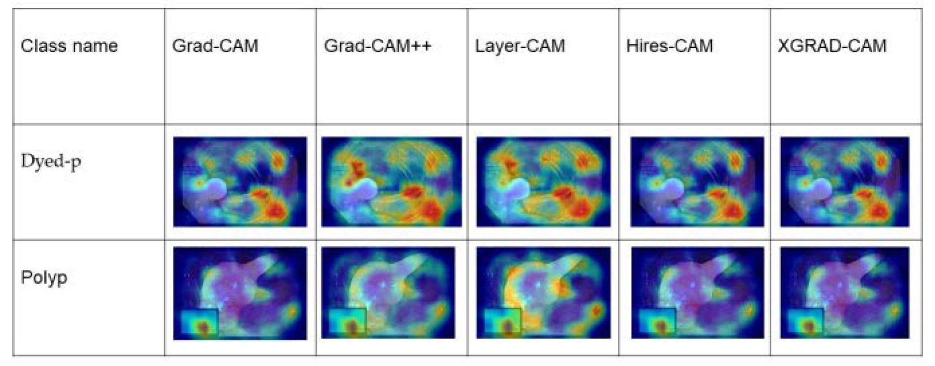
Result of XAI methods
Fig2: The output of the explainable heat map for dyed-p and polyp.
The output of the classification heat map shows that all types of explainable models, including the Grad–CAM, Grad–Cam++, Layer–Cam, Hires–Cam, and Xgrad–CAM, have almost similar results, whereas Grad–CAM++ obtained higher heat maps on both dyed-p and polyp classes. As dyed-p consists of more fixtures in the image, it has a more accurate heat map than the polyp class

Slide 7
Result Comparison on the dataset
Author | Model | Dataset | Accuracy
Sandler | MobileNetv2 | Kvasir | 79.15 %
Borgli | Teacher–student Framework | HuperKvasir | 89.3 %
Srivastava | FocalConvNet | Kvasir | 63.7%
Pozdeev | Custom CNN for two-stage classification | Kvasir | 88.00%
Fonolla | Multi-model Classification | Kvasir | 90.20%
Methods used in the paper | ResNet-152 combined with Grad–CAM | Kvasir | 93.46 %
Table3: The results of comparison experiments.

Slide 8
Conclusion and Future Work
This study proposed an explainable artificial intelligence method for wireless endoscopic image classification using ResNet-152 combined with Grad–CAM.
The research helps to open the black box of deep learning performance in endoscopic images which can improve the diagnostic accuracy of endoscopic examinations.
The authors plan the future direction to improve model performance to modify new updates in further works.
Paper Link:
https://www.mdpi.com/1424-8220/23/6/3176

